Slide 1

Architecture details of DenSformer
Sharin Shahana
Project Associate, IISc

Slide 2
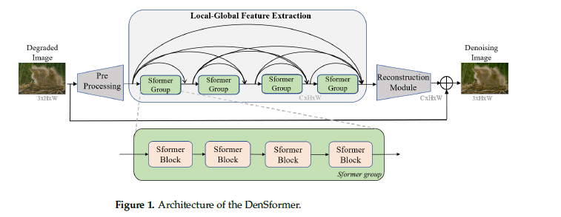
Dense Residual Transformer for Image Denoising
DenSformer is an image denoising network structure based on the Transformer architecture.

Slide 3
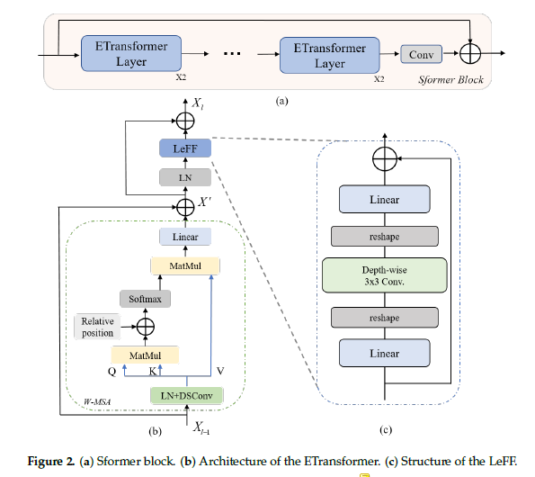

Slide 4
Dense Residual Transformer for Image Denoising
It consists of three modules: a preprocessing module, a local-global feature extraction module, and a reconstruction module.
The patch size of the input image is 40 × 40.
The preprocessing module uses a 3x3 convolutional layer to extract shallow features from the input image.
The local-global feature extraction module is designed to extract local and global features from the shallow features. It includes 4 Sformer groups, each containing 4 Sformer block and each of these blocks contain 4 ETransformer layers and a 3x3 convolution layer. These Sformer groups are are assembled by some dense skip connections as well as long skip connections.

Slide 5
Dense Residual Transformer for Image Denoising
The reconstruction module is made up of a 3x3 convolutional layer, reconstructs the high-quality image by combining the deep features with the shallow features using a long skip connection.
The number of feature channels used in the network is 64.
The dimensions of keys, query, values, linear layer and reshape layer is not mentioned in the paper.

Slide 6
Number of Sformer groups | 4
Number of Sformer block | 4
Number of Etransformer layer | 4
Number of feature channel | 64
Patch size of input image | 40x40
Dimensions of convolutional layer | 3x3
Dimensions of linear layer
Dimensions of key, query and value
Dimensions of reshape layer
Table 1: Summary of architectural details of DenSformer

